Slide 1
Lecture 5: Logistic Regression
Instructor: Yang Xu
Slides adapted from Xiaobai Liu

Slide 2
Recap: Linear Regression
Linear regression model
Cost function: Mean Square Error
Gradient descent

Slide 3
Outline
Logistic regression model
Gradient descent method

Slide 4
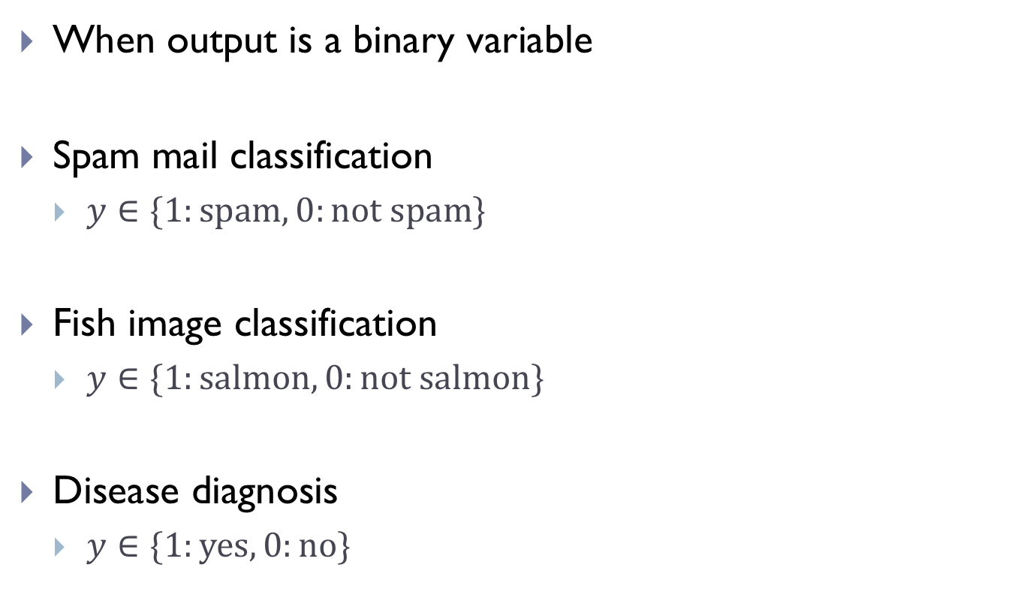
Binary Classification Problems
When output is a binary variable
Spam mail classification
$y∈\{1:\text{spam}, 0:\text{not} \text{spam}\}$
Fish image classification
$y∈\{1:\text{salmon}, 0:\text{not} \text{salmon}\text{\}}$
Disease diagnosis
$y∈\{1:\text{yes}, 0:\text{no}\text{\}}$

Slide 5
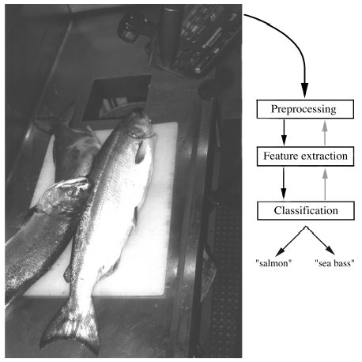
Case: fish image classification
Feature: pixels of image
Grayscale data
8 by 8 pixels
Stack m images into a matrix
Training

Slide 6


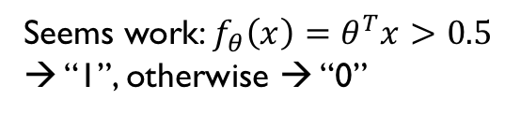
Deal with binary classification
What if using linear regression?
$$y$$
Seems work: $f_{θ}\left(x\right)=θ^{T}x>0.5$ → “1”, otherwise → “0”
Problem?
Mis-classification!
1
0.5
0
$$x$$

Slide 7
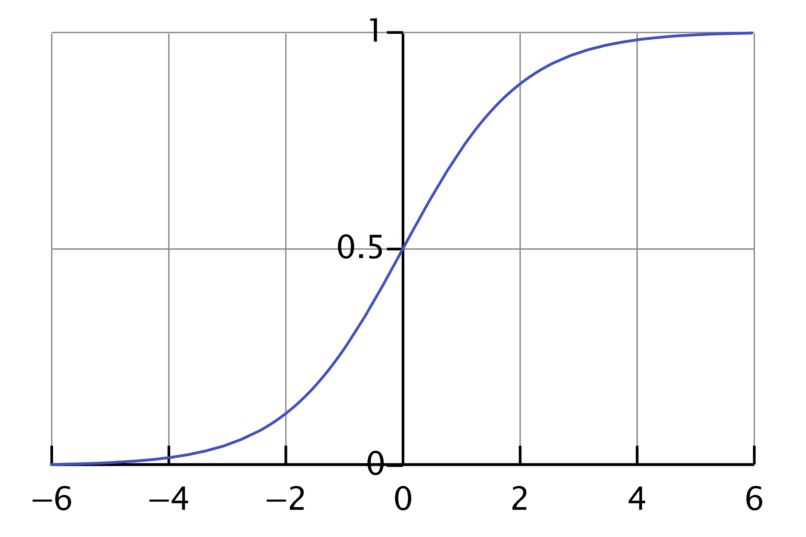
New function other than a linear function
Need a function whose output is bounded to [0, 1]
Choose
in which
Sigmoid function

Slide 8
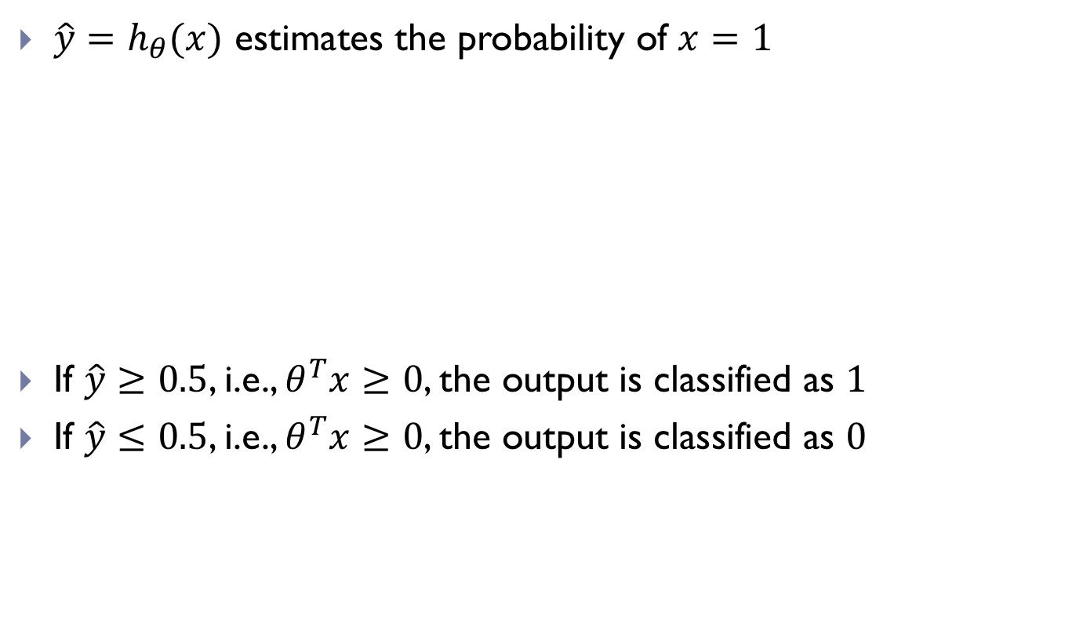

Understanding $h_{θ}(x)$
$\hat{y}=h_{θ}(x)$ estimates the probability of $x=1$
If $\hat{y}≥0.5$, i.e., $θ^{T}x≥0$, the output is classified as $1$
If $\hat{y}≤0.5$, i.e., $θ^{T}x≥0$, the output is classified as $0$

Slide 9
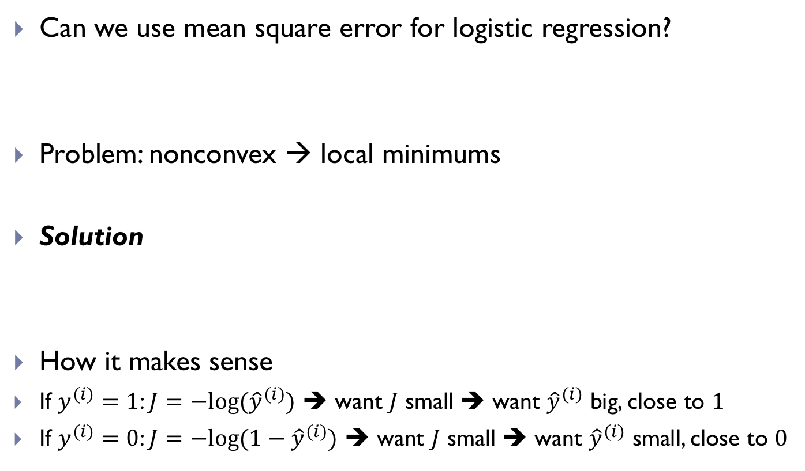
How to choose cost function?
Can we use mean square error for logistic regression?
Problem: nonconvex → local minimums
Solution
How it makes sense
If $y^{(i)}=1$: $J=−log⁡({\hat{y}}^{(i)})$ ➔ want $J$ small ➔ want ${\hat{y}}^{(i)}$ big, close to $1$
If $y^{(i)}=0$: $J=−log⁡(1−{\hat{y}}^{(i)})$ ➔ want $J$ small ➔ want ${\hat{y}}^{(i)}$ small, close to $0$

Slide 10
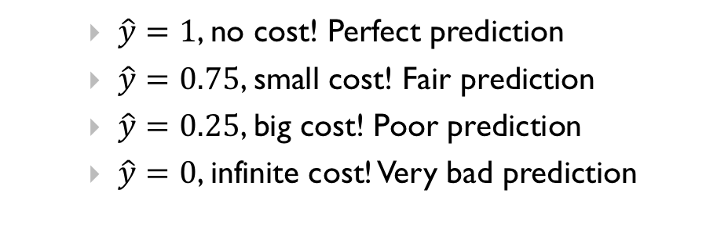

Thoughts behind the cost function
A good cost function needs to give larger penalty to examples that are more wrong
If $y=1$, $J\left(θ\right)=−log⁡(\hat{y})$
$\hat{y}=1$, no cost! Perfect prediction
$\hat{y}=0\text{.75}$, small cost! Fair prediction
$\hat{y}=0.\text{25}$, big cost! Poor prediction
$\hat{y}=0$, infinite cost! Very bad prediction

Slide 11

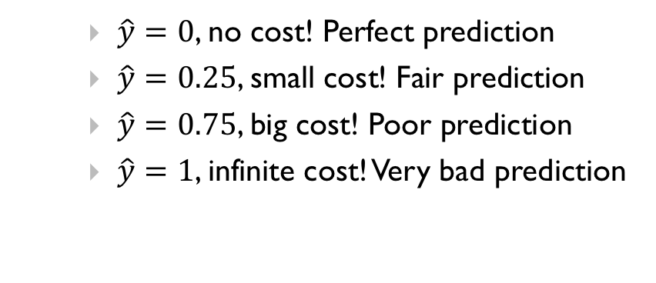
Thoughts behind the cost function (cont.)
If $y=0$, $J\left(θ\right)=−log⁡(1−\hat{y})$
$\hat{y}=0$, no cost! Perfect prediction
$\hat{y}=0.25$, small cost! Fair prediction
$\hat{y}=0.75$, big cost! Poor prediction
$\hat{y}=1$, infinite cost! Very bad prediction

Slide 12
Cost function in one line
Is just a compact way of defining:
In which

Slide 13
Some probability thoughts
Compact way:
Given data $𝔇=\{\left(x^{\left(i\right)},y^{\left(i\right)}\right),(x^{(2)},y^{(2)}),⋯, (x^{(m)},y^{(m)})\}$
Goal: fit $θ$ so that it maximizes the likelihood of data
Same as maximizing the log-likelihood
Looking familiar?

Slide 14

Probability origin of cost function
Cost function is the negative log-likelihood!
Minimizing the cost function is equivalent to maximizing the likelihood of data over $θ$, i.e. $P(𝔇|θ)$

Slide 15
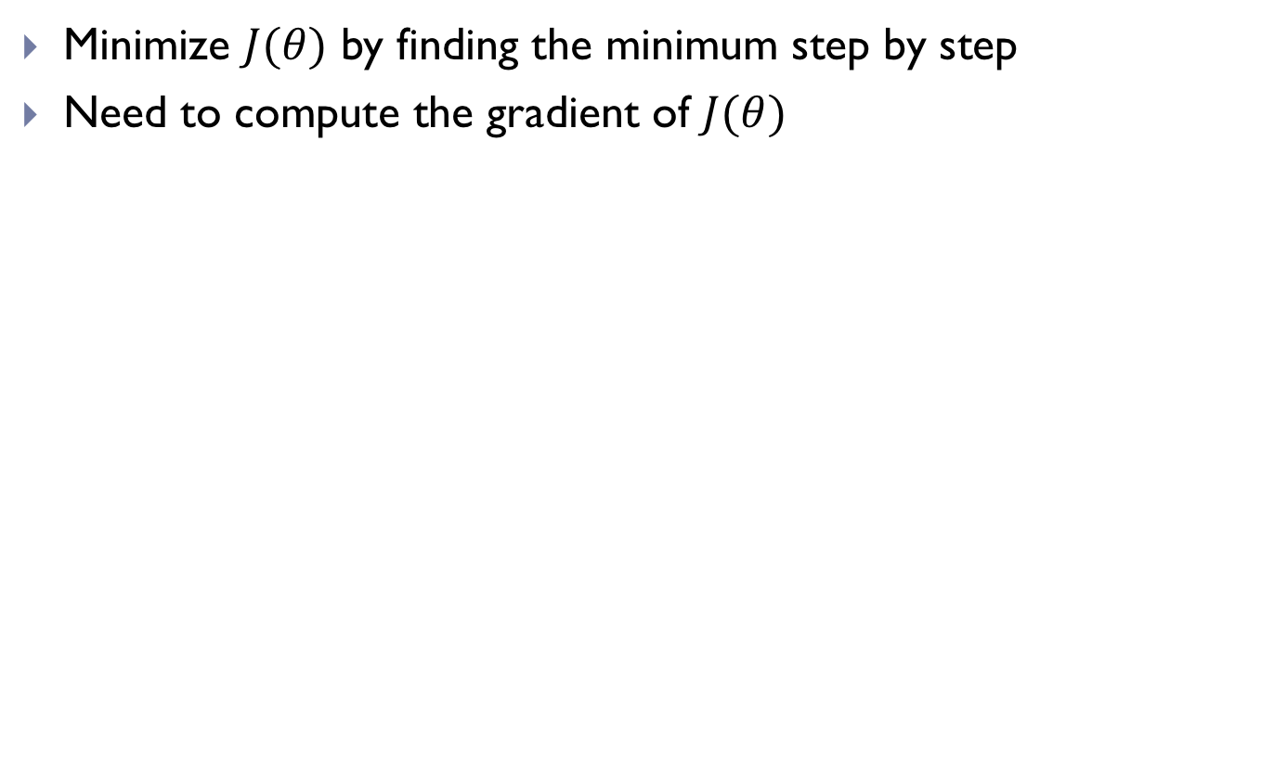
Gradient descent
Minimize $J(θ)$ by finding the minimum step by step
Need to compute the gradient of $J(θ)$
Key:

Slide 16

Derivative of sigmoid function
using the chain rule
Since $θ$ and $x$ are vectors

Slide 17
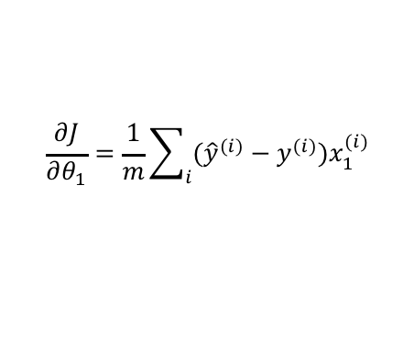
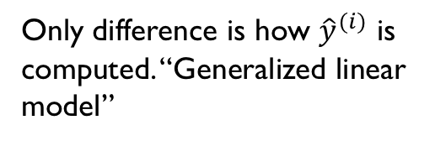
Gradient of cost function
Plug in to the partial derivative of the cost function
Only difference is how ${\hat{y}}^{(i)}$ is computed. “Generalized linear model”
Complete form
Similar to linear regression
$$\frac{∂J}{∂θ_{1}}=\frac{1}{m}\sum_{i}{({\hat{y}}^{(i)}−y^{(i)})x_{1}^{(i)}}$$

Slide 18
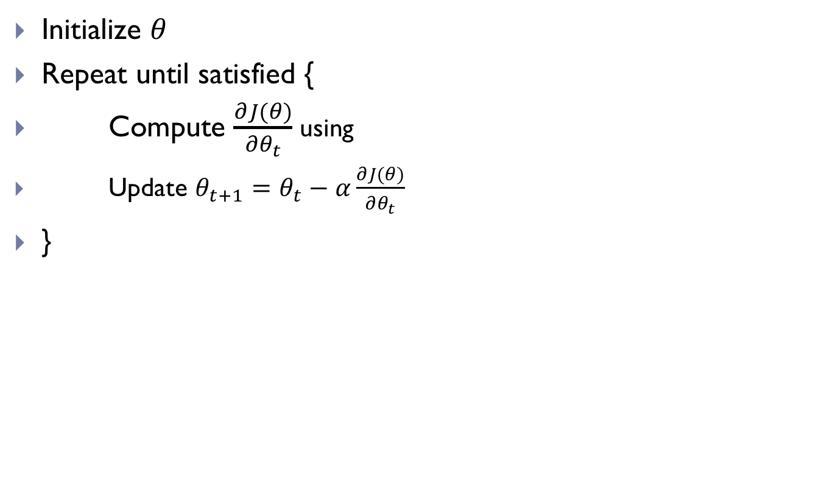
Gradient Descent
Initialize $θ$
Repeat until satisfied {
Compute $\frac{∂J(θ)}{∂θ_{t}}$ using
Update $θ_{t+1}=θ_{t}−α\frac{∂J(θ)}{∂θ_{t}}$
}

Slide 19
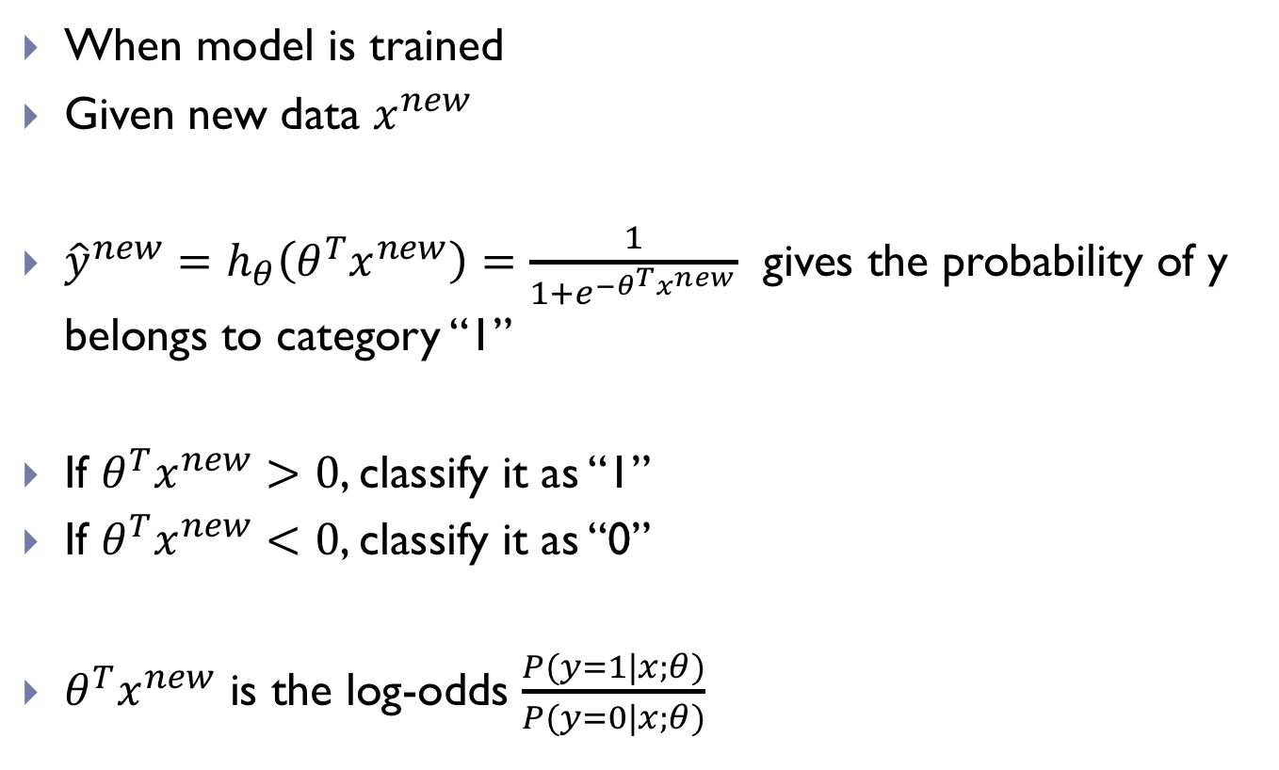
Make predictions
When model is trained
Given new data $x^{new}$
${\hat{y}}^{new}=h_{θ}\left(θ^{T}x^{new}\right)=\frac{1}{1+e^{−θ^{T}x^{new}}}$ gives the probability of y belongs to category “1”
If $θ^{T}x^{new}>0$, classify it as “1”
If $θ^{T}x^{new}<0$, classify it as “0”
$θ^{T}x^{new}$ is the log-odds $\frac{P(y=1|x;θ)}{P(y=0|x;θ)}$

Slide 20
Practice1: nonlinear Transformation
Sigmoid function
Other choice: Tangent

Slide 21
Data notations
Training data of m examples
Dimensions:
Stack by columns into a matrix
(A way better for future neural network models)

Slide 22
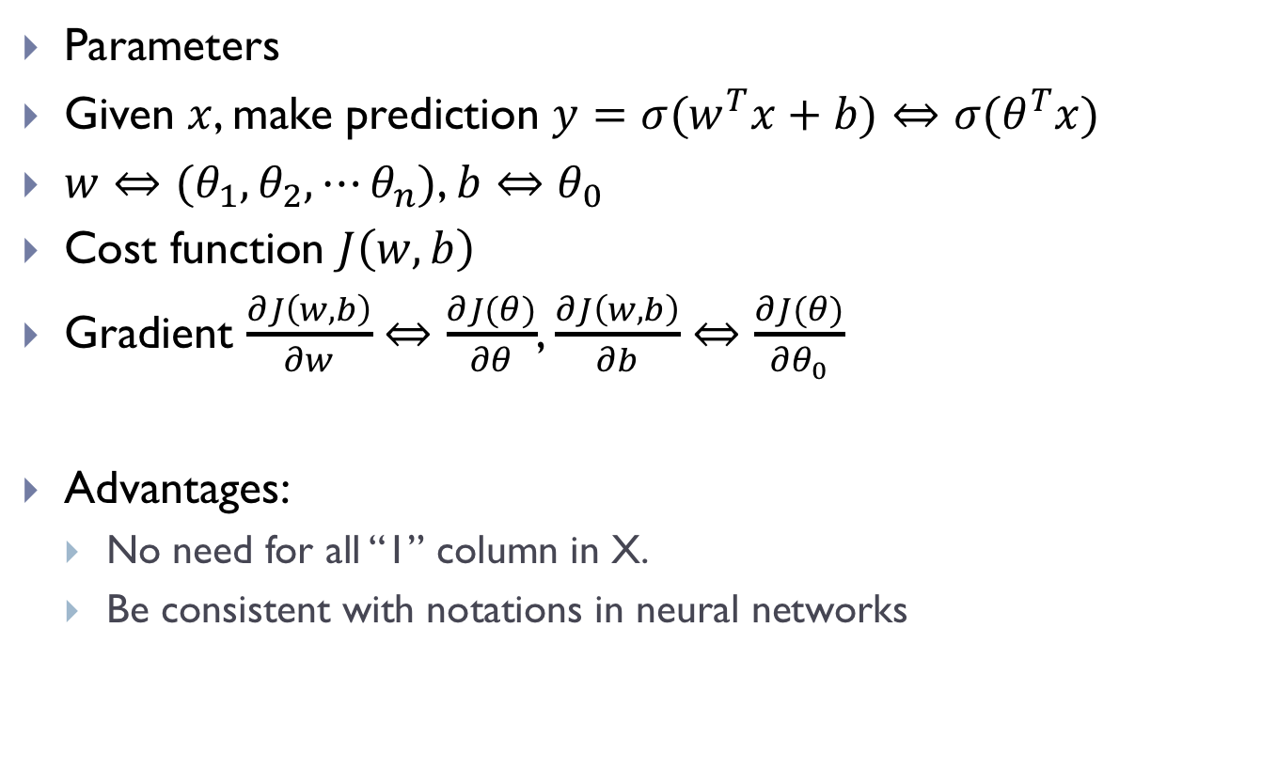
Parameter notations
Parameters
Given $x$, make prediction $y=σ(w^{T}x+b)⇔σ(θ^{T}x)$
$w⇔(θ_{1},θ_{2},⋯θ_{n})$, $b⇔θ_{0}$
Cost function $J\left(w,b\right)$
Gradient $\frac{∂J\left(w,b\right)}{∂w}⇔\frac{∂J(θ)}{∂θ}$, $\frac{∂J\left(w,b\right)}{∂b}⇔$ $\frac{∂J(θ)}{∂θ_{0}}$
Advantages:
No need for all “1” column in X.
Be consistent with notations in neural networks

Slide 23
Recap
Logistic regression
Gradient descent
Question: what about multi-category classification problem?
Covered next lecture

Slide 24
Next lecture
Evaluation of ML system

